Slide 1

Welcome
Year 2 staff: Mrs Jones, Mrs Edwards, Mr McTaggart
Pastoral Lead: Miss Burns
Safeguarding Team: Mrs Foreman, Mr Long, Mrs Jones, Mrs Osborne, Miss Burns
Senior Leadership Team: Mr Long (HT), Mrs Foreman (DHT), Mrs Osborne (AHT), Mrs O’Brien (SENDCo) and Mrs Southern (EYFS)

Slide 2
Year 2 Highlights
Trips: Church to look at baptism, Sefton park Palm house, Farm
My favourite part of teaching Year 2: The best part of teaching Year 2 is watching children make the huge leap into becoming confident, independent learners. There is so much excitement in their learning and watching those moments of pure pride in their own work.

Slide 3
Daily Routines:
Attendance & Punctuality
Attendance & Punctuality:
Targets
Gates open: 8.40am
Gates close: 8.50am
Learning starts when the children enter the room with a short Maths activity
Please report any absences to the school office and share any medical evidence
Missing 10 minutes a day adds up quickly – it is the same as missing a whole day by October half term
97% + is our national attendance target
90% or below is classed as persistently absent and could risk a fine
BUT also risks your child missing out on key learning, time with friends and exciting activities (including special visitors)

Slide 4
Daily Routines:
Packed Lunches
Benedict’s Law:
Allergy friendly policies – no treats for birthdays, no tuck shop
Packed Lunch Policy:
Healthy choices
No fizzy drinks

Slide 5
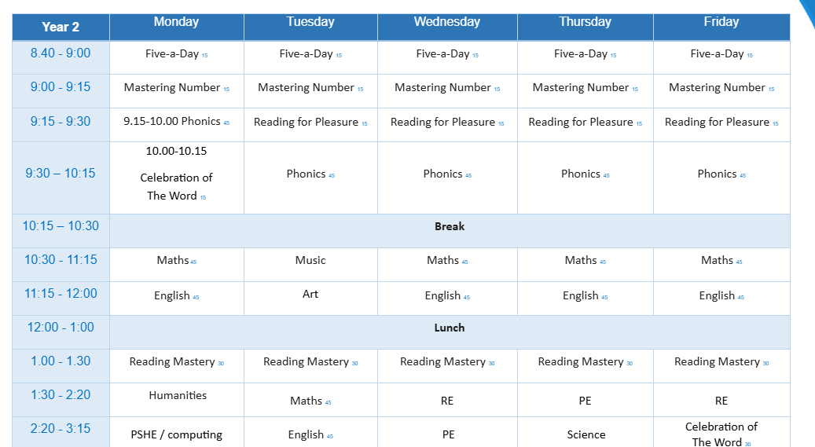
Daily Routines:
Weekly Timetable

Slide 6
Daily Routines:
Uniform
School Uniform:
PE Uniform
Winter Uniform (September - Easter Holidays)
  Grey trousers or shorts / grey skirt, grey pinafore dress
  White shirt and school tie
  Royal blue V-neck jumper or cardigan (with school logo preferred)
  Grey or white socks / tights
  Black, sensible school shoes (no trainers, boots or open-toed footwear)
Summer Uniform (Easter Holidays - July)
  White polo shirt (with school logo preferred)
  Grey skirt, grey pinafore dress or grey shorts
  Royal blue V-neck jumper or cardigan (with school logo preferred)
  Grey or white socks
  Black, sensible school shoes
or
  blue/white checked summer dress
  Royal blue V-neck jumper or cardigan (with school logo preferred)
  White socks
  Black, sensible school shoes or closed-toe sandals (with appropriate ankle strap for safety; no open-toed sandals, crocs, or fashion sandals)
White t-shirt with the school logo
Royal blue, plain shorts
Black pumps (indoor P.E.)
Trainers (outdoor P.E.)
Royal blue school tracksuit with the school badge (for colder weather, outdoor P.E.)
P.E. uniform should be worn to school on PE days.
Although we promote the use of items that display the school badge - generic, logo-free alternatives are fully acceptable across all items
PE on Wednesday and Thursday

Slide 7
Academics and Expectations:
School
Year 2 Curriculum Expectations:
High! Children are expected to work with increasing independence, taking responsibility for looking after their belongings, presenting their work neatly, and showing positive classroom leadership.

Slide 8

Academics and Expectations:
Reading

Slide 9

Academics and Expectations:
Spelling

Slide 10
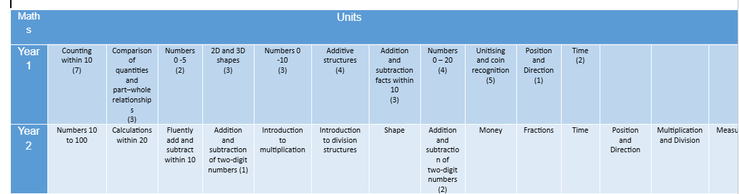
Academics and Expectations:
Maths

Slide 11
Academics and Expectations:
Foundation Subjects
RE: Creation and Covenant
Science: Animals and living things
History: Fighting fit, Florence Nightingale
Computing: What is a computer
PE: Ball skills
Art: Drawing, tell a story
Music: Folksongs
PSHE: My happy mind

Slide 12
Academics and Expectations:
Assessment
Assessment Points:
Termly assessments – will be using previous SATs papers to support
Reading speed and writing speed also monitored
Statutory Assessments:
Year 2 phonics screening recheck
KS1 SATS are no longer mandatory
Ongoing assessment in reading, writing, Maths and Science

Slide 13
Academics and Expectations:
Home
Homework:
Reading: 10 minutes, 3 times per week
Spellings: around 10 words per week
Other tasks: short English and Maths task to practise skills taught in lessons, short creative/research task for a foundation subject
Homework will go out on a Friday and due back in by Thursday the following week.

Slide 14
Academics and Expectations:
Behaviour
Policy
Designed to keep everyone safe, learning and ensure an inclusive learning environment for all our pupils
Three warnings given before a reflection
Two reflections within a half term will mean parents invited into school
Rewards
DoJo points: consistent number of points given by all members of staff for lovely manners, outstanding effort in a piece of work etc

Slide 15
Academics and Expectations:
Inclusion
SEND:
Monitoring: please discuss any concerns with class teachers initially
Further conversations: sometimes a more in-depth conversation will be needed, this will be arranged directly with families
Referrals: completed with information from home and school, currently long waiting lists, staff receive regular training on teaching approaches to foster inclusion
Pupil profiles: reviewed three times per year, SMART targets set
Environment:
What is necessary for some is good for all – we are aiming for calm, considered classrooms and corridors to celebrate and enable all children’s work

Slide 16
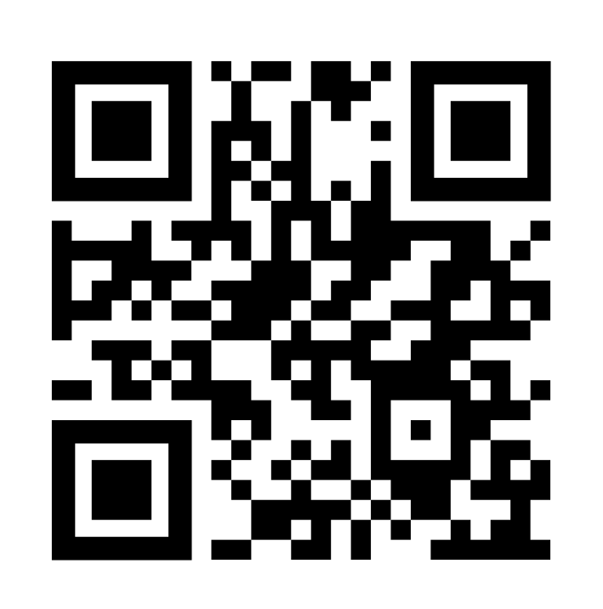
Communication:
Online
Arbor and ClassDojo:
Instagram:
Arbor:
Emails and in-app messages for updates and key dates for diaries.
Attendance information shared.
Class Dojo:
One way broadcasting – messages are not monitored
@ourladyandstphilomenas
Useful information and reminders as well as pictures.
Follow the QR code here:

Slide 17
Communication:
In-person
General:
Miss Sweeney and Miss Callaghan are happy to help you with general enquiries
Class Teachers:
Request an appointment or call through the office

Slide 18
Key Actions
Medical Needs: All medical forms must be completed and signed
Allergies: Remember new Packed Lunch Policy; no cake, sweets or treats for birthdays; no tuck
Individual Healthcare Plan (IHP): Needs to be completed for any child with an allergy

